Slide 1
Data Visualizations using Python
CTEC 298 Final Project
David Okeke

Slide 2
Table of Contents
Introduction
Summary of CTEC 128 paper
Description of CTEC 298 material submitted
Description of the plot deliverables
Summary/conclusion
References
Thank you

Slide 3
Introduction
In this final project I will be showcasing what I learned in CTEC 298
By elaborating on the different projects regarding big data, data management and data visualization
I will also be using prior knowledge from CTEC 128 to assist me with various projects

Slide 4
Summary of CTEC 128 Papers
The topics talked about in CTEC 128 was about analyzing how the means of transportation has changed over time based on various variables
The goal of the project was to give readers insight on how preferences, location, salary/wages play in transportation choices.

Slide 5
Description of CTEC 298 Material Submitted
In CTEC 298 I was exposed to concepts of data science, bid data, data analysis techniques, and basic research methods.
I also learned the basics of data visualization, data manipulation, and data management.
We used Dataquest, Matplotlib, Jupyter Notebook etc

Slide 6
Description of Plot Deliverables
Using the data from CTEC 128 we were to
Import data to Jupyter Notebook
Display original data (Head, Tail)
Display Wrangled data (Head, Tail) *if applicable
Display six plots

Slide 7
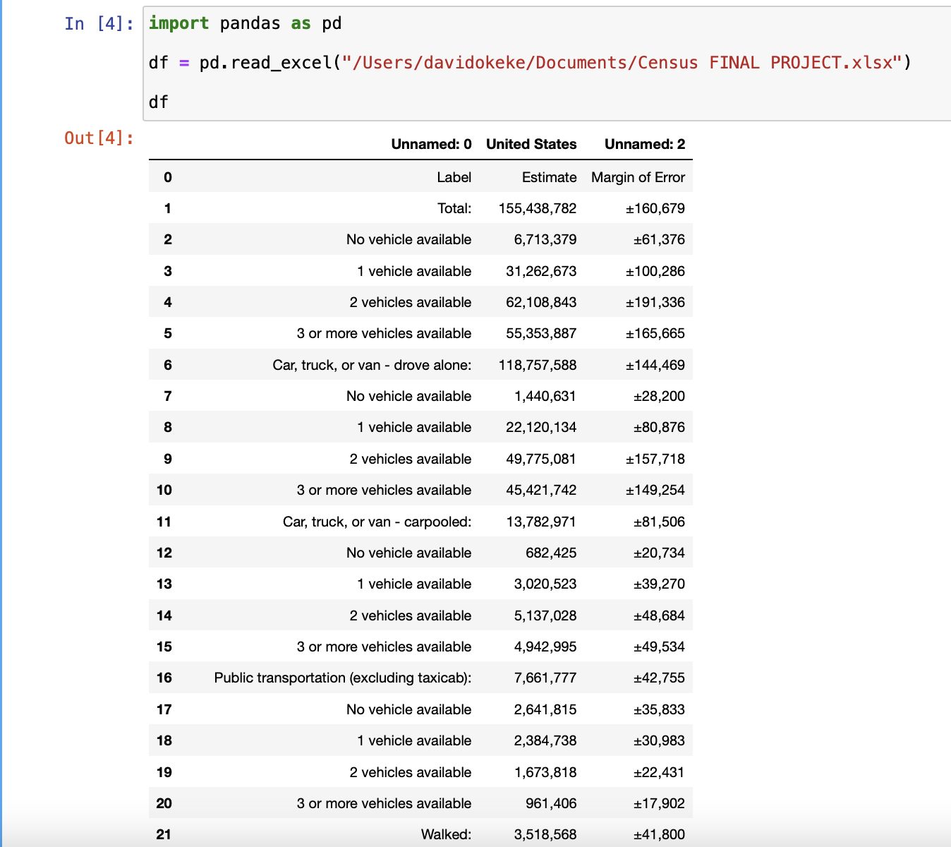
Description of Plot Deliverables
Screenshot of importing the data into Jupyter Notebook

Slide 8
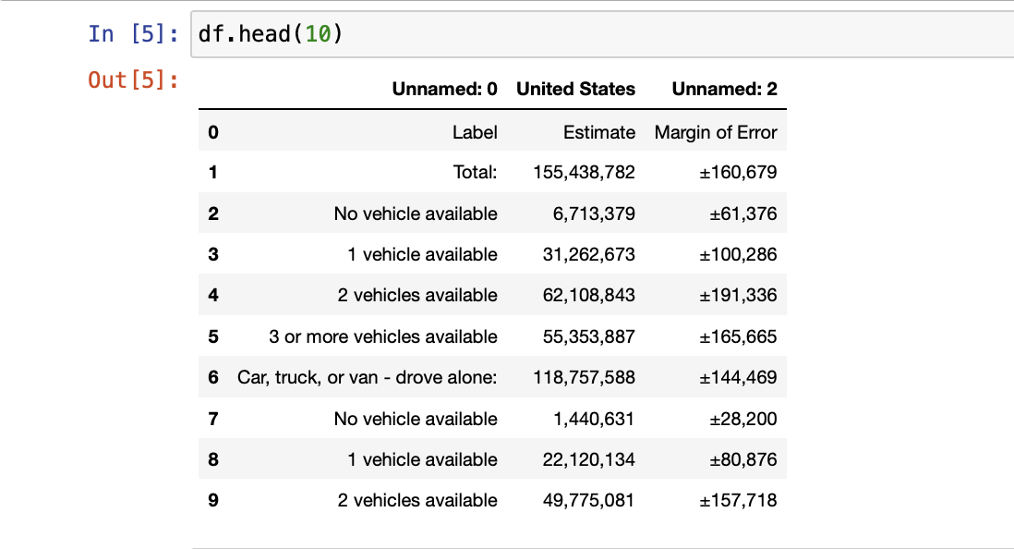
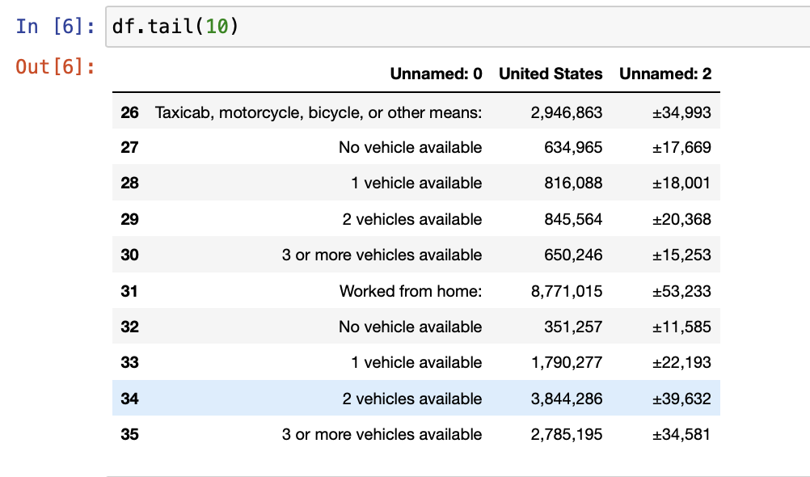
Description of Plot Deliverables
Screenshot of the original data (Head, Tail)

Slide 9
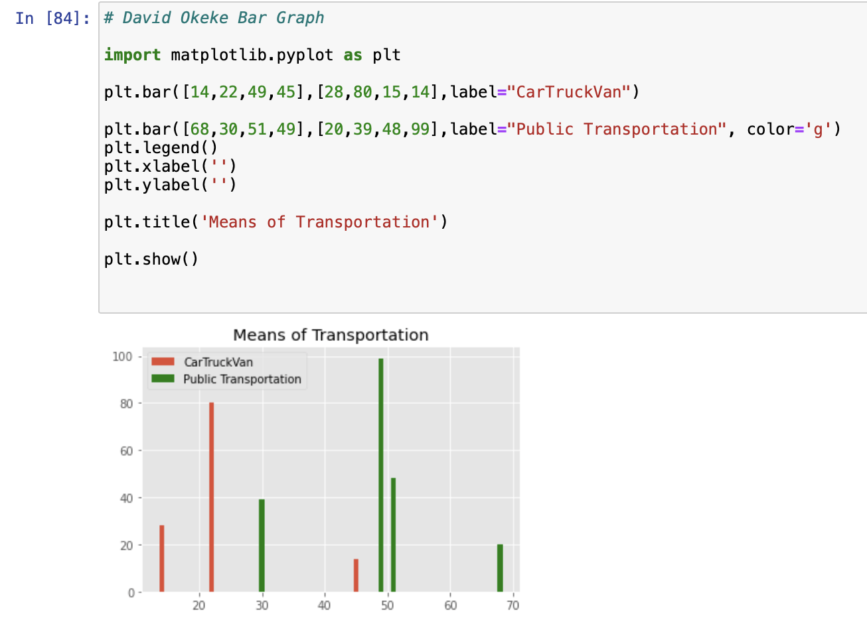
Description of Plot Deliverables
This screenshot displays the data from the CTEC 128 Excel on the bar graph

Slide 10
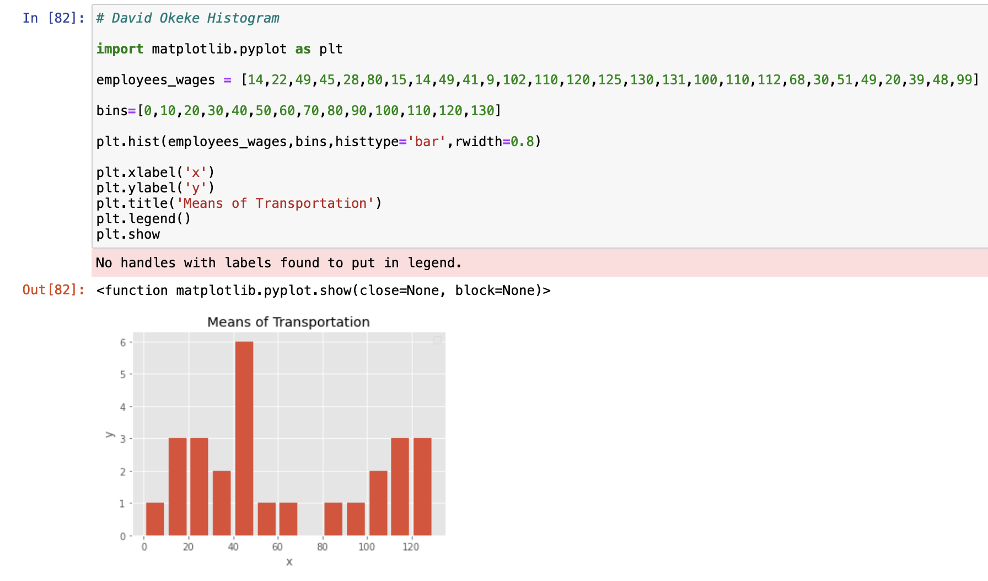
Description of Plot Deliverables
This screenshot displays the data from the CTEC 128 Excel on the histogram

Slide 11
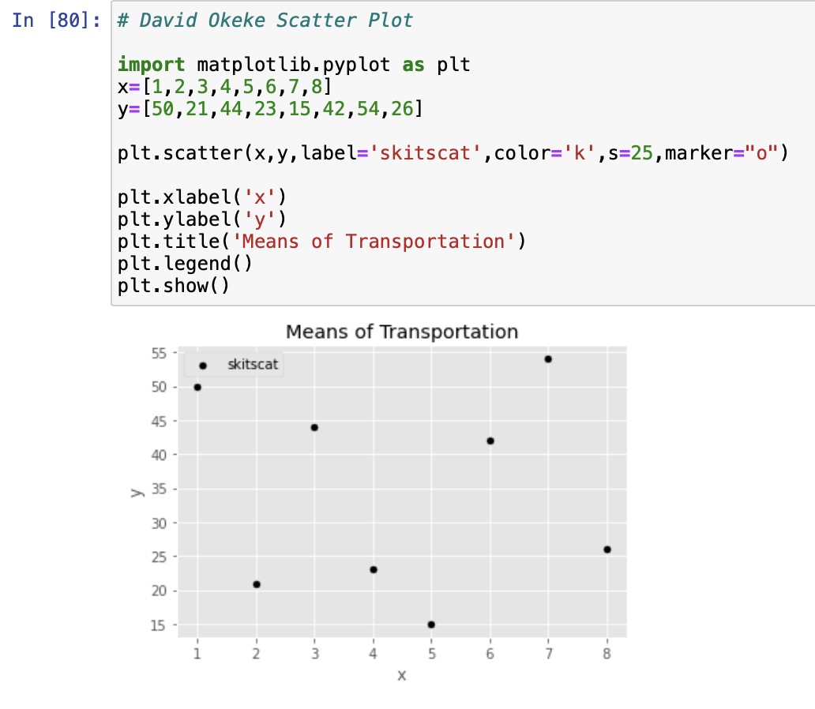
Description of Plot Deliverables
This screenshot displays the data from the CTEC 128 Excel on the scatter plot

Slide 12
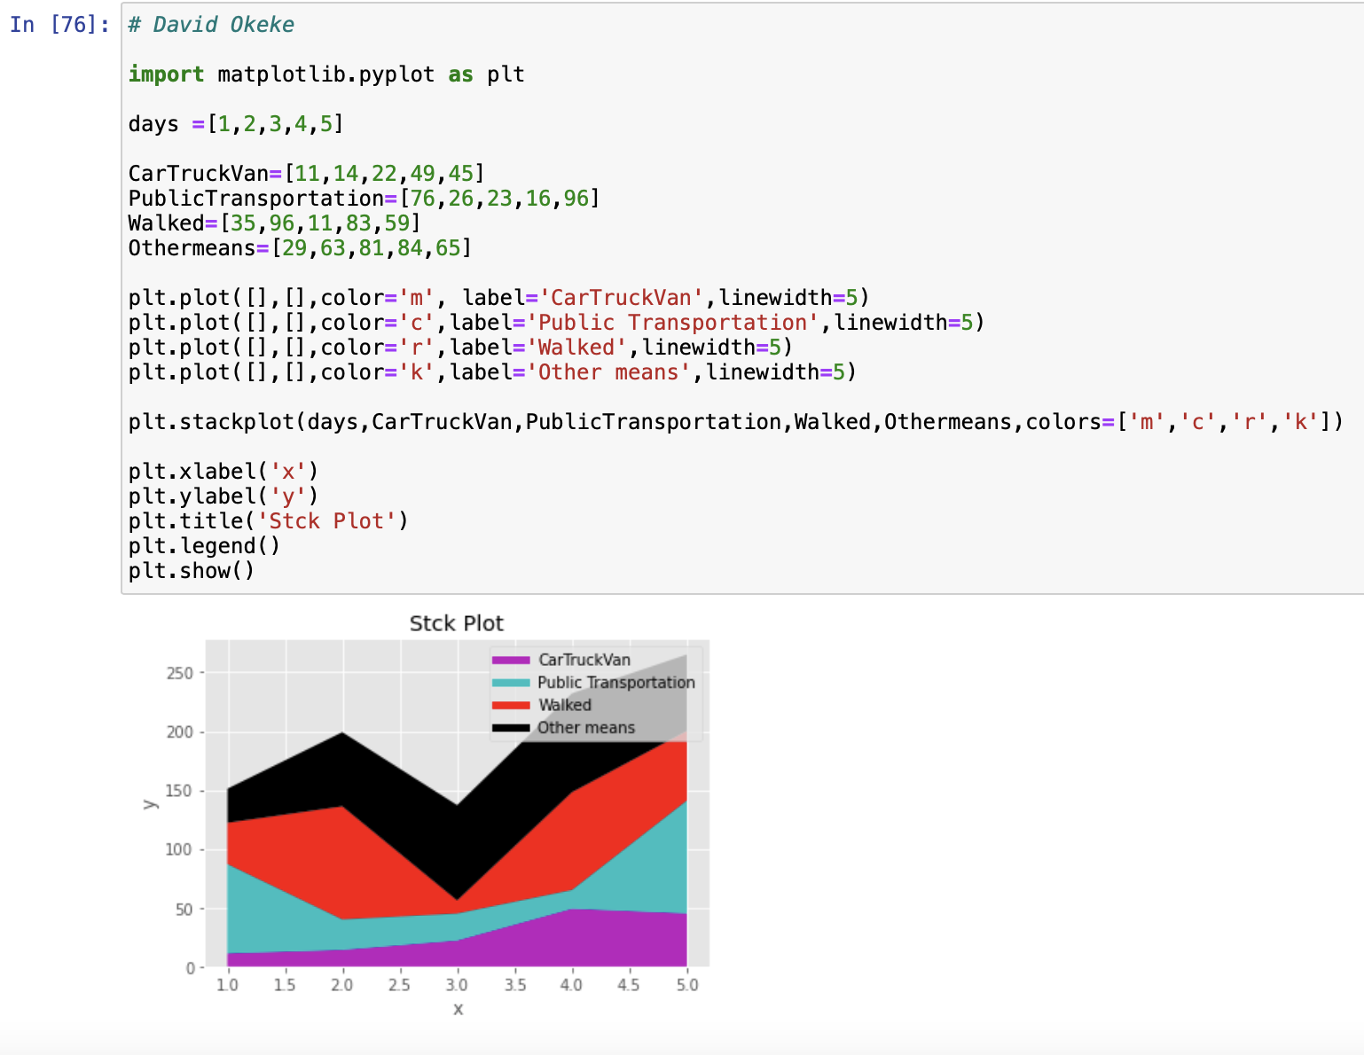
Description of Plot Deliverables
This screenshot displays the data from the CTEC 128 Excel on the stack plot

Slide 13
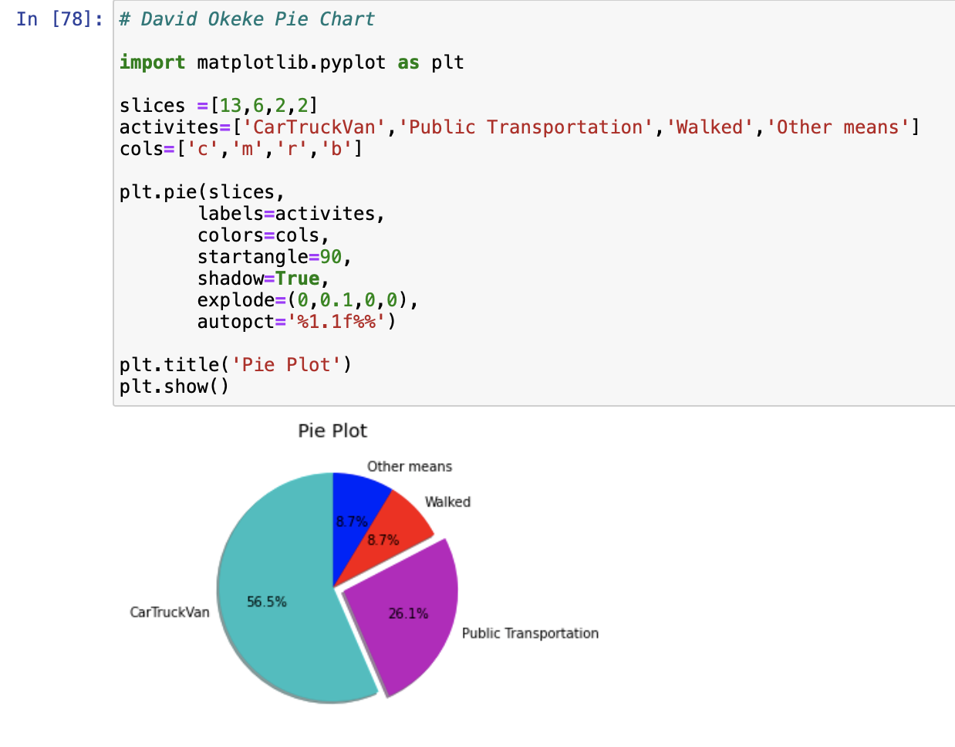
Description of Plot Deliverables
This screenshot displays the data from the CTEC 128 Excel on the pie plot

Slide 14
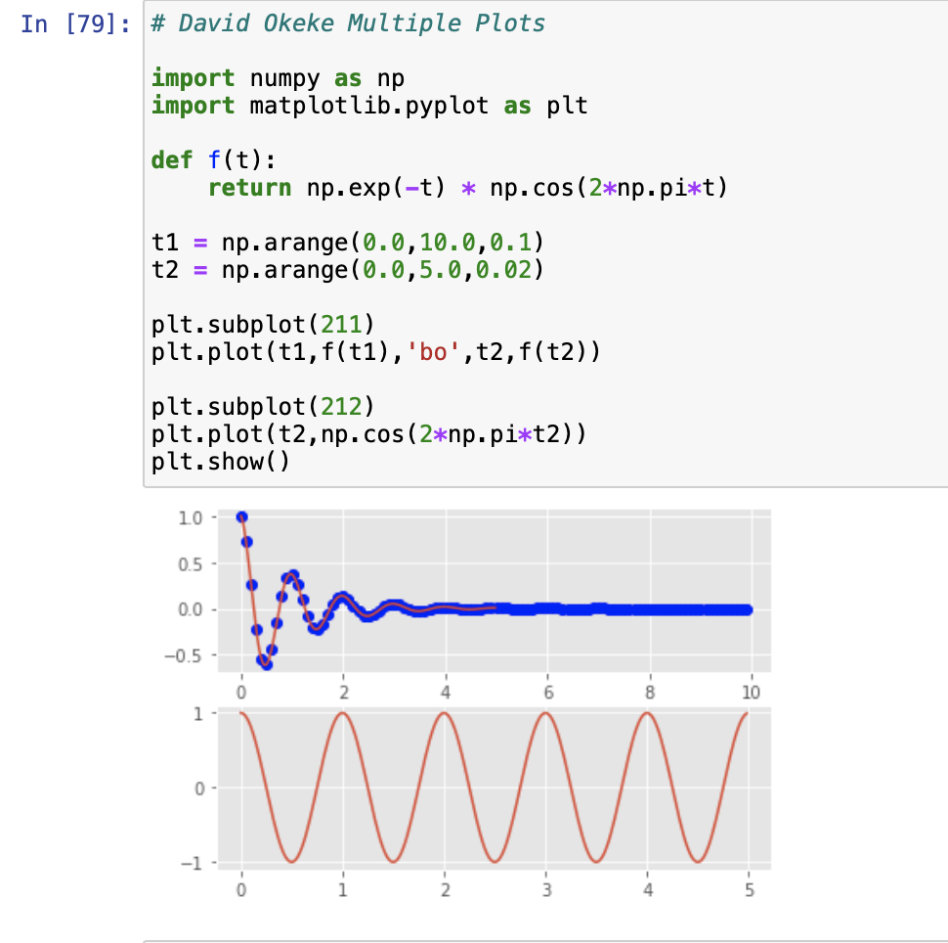
Description of Plot Deliverables
This screenshot displays the data from the CTEC 128 Excel on the multiple plots

Slide 15
Summaries/Conclusion
In CTEC 298 I was exposed to concepts of data science, bid data, data analysis techniques, and basic research methods.
I also learned the basics of data visualization, data manipulation, and data management via data mining, analysis tools, queries, visualization, logic/coding statements, and other key techniques.

Slide 16
References
Project jupyter. Project Jupyter. (n.d.). Retrieved October 19, 2021, from https://jupyter.org/.
Visualization with python¶. Matplotlib. (n.d.). Retrieved October 19, 2021, from https://matplotlib.org/.
Pandas. pandas. (n.d.). Retrieved October 19, 2021, from https://pandas.pydata.org/.
What is tableau? Tableau. (n.d.). Retrieved October 19, 2021, from https://www.tableau.com/why-tableau/what-is-tableau.

Slide 17
Thank you!!

